Slide 1

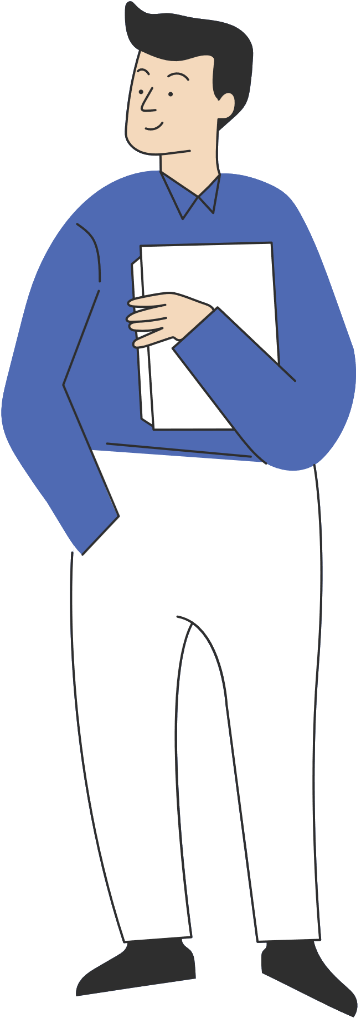

GOOGLE MERCHANDISE STORE

Slide 2

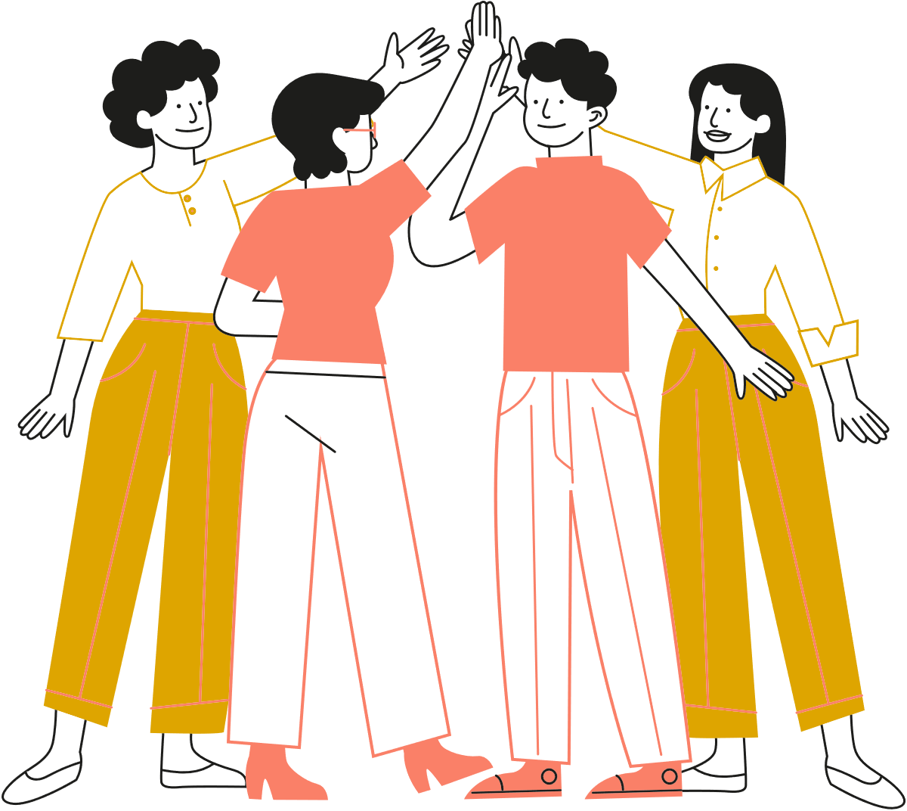
1
Duong Bich Giang
OUR TEAM
2
Oluwatobi Ashinwo Adeleke
3
Elizabeth Wanjiku Waweru
4
Anjali Bai
5
Nathasia Nyarkoah Amoani

Slide 3
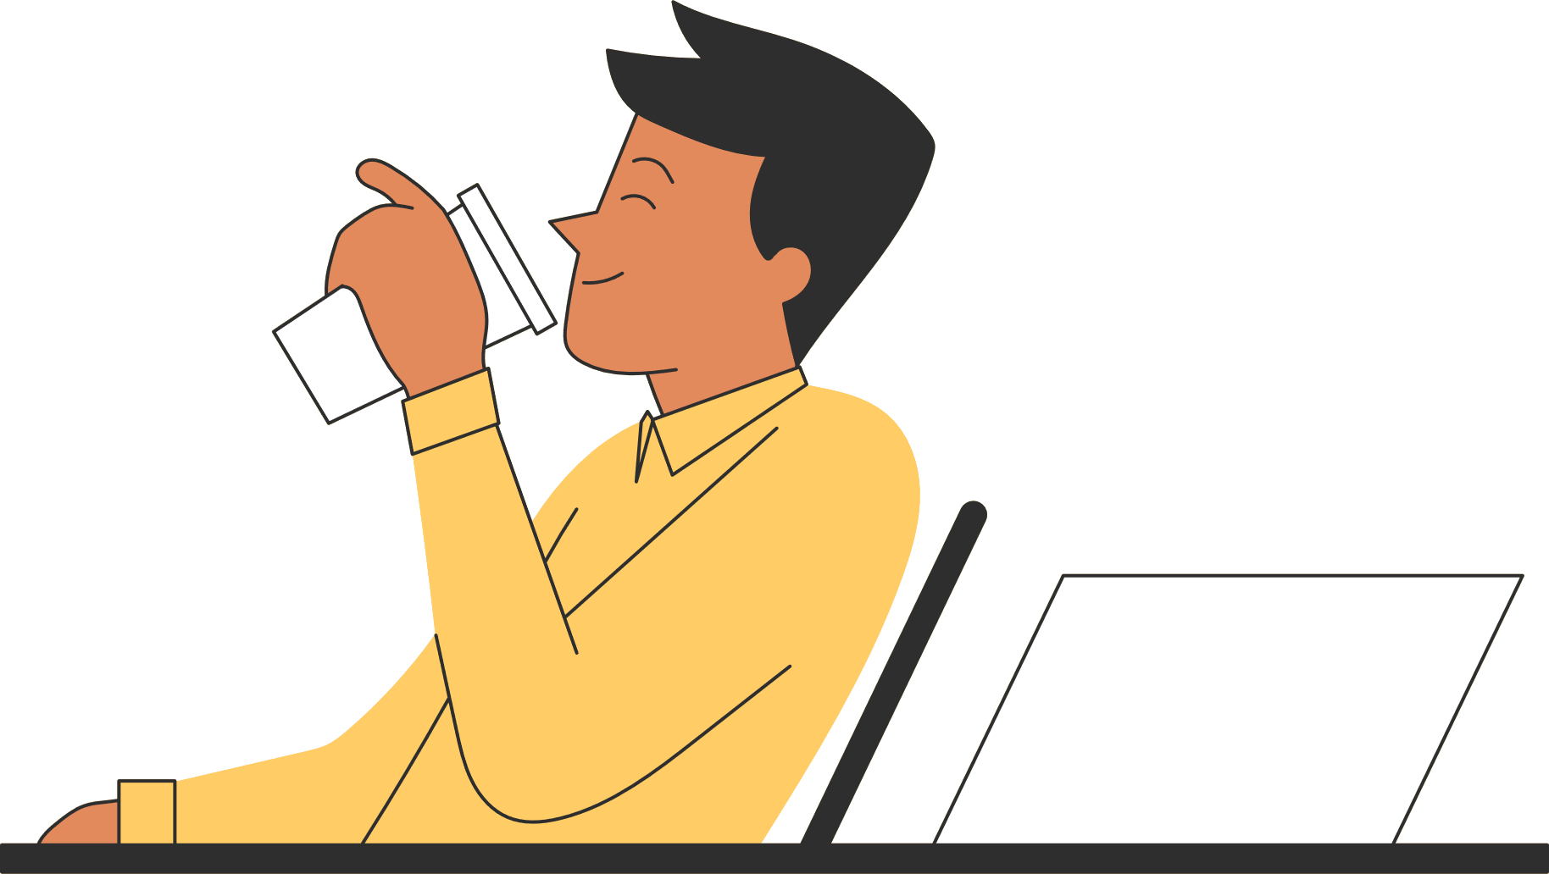
1
Overview and our goals
TODAY'S AGENDA
2
Audience Analysis
3
Channel Analysis
4
Products Analysis
5
Conclusion

Slide 4

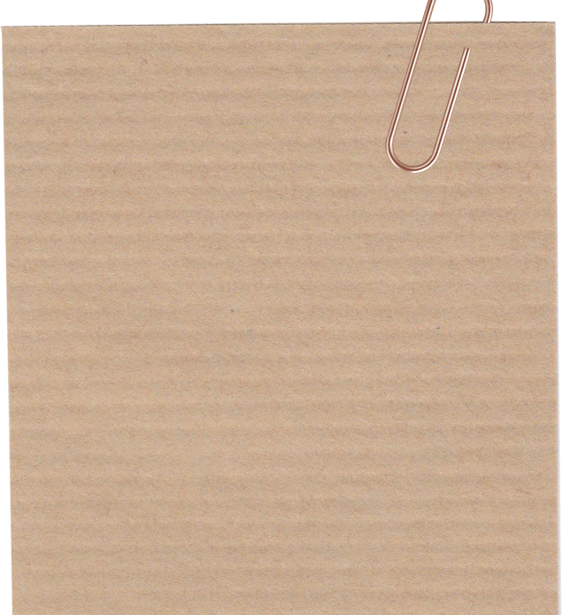
GOALS
OVERVIEW
Examine digital performances of the Google Merchandise Store website over the course of the last six months.
The analysis will be divided into three key directions in order to give pertinent observation and generate persuasive solutions
Analysis examined through the gathering of relevant data on the Google Analytics platform.
An E-commerce section from Google.
Sells Google Merchandise such as:
1. Lifestyle products.
2.Stationary from Google (And Google owned brands such as YouTube, Google Cloud, Android).
3. Apparel

Slide 5
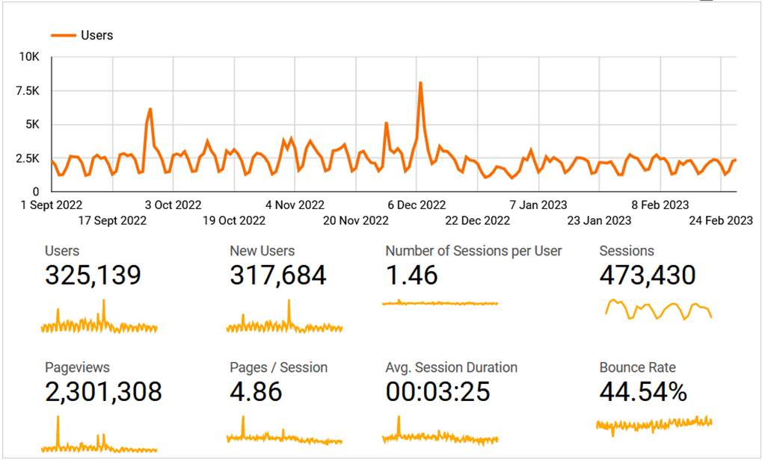

AUDIENCE
Audience - Overview
What happened?
Site engagement is fairly below average
Only 1.46 sessions per user
Slightly higher than average bounce rate of 44.54 %.
Solutions
Creating Hero content (Either in home or product page). This will help Google have a larger retention rate and increase sales.
Satisfy search Intent. They need to give what searchers are looking for. To avoid visitors bouncing back to the search results.

Slide 6
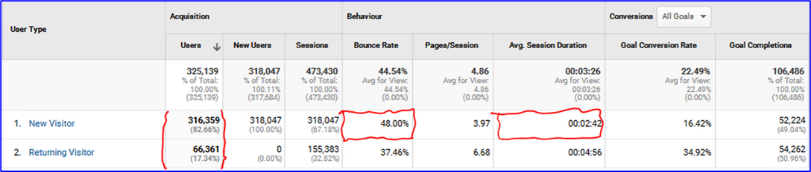
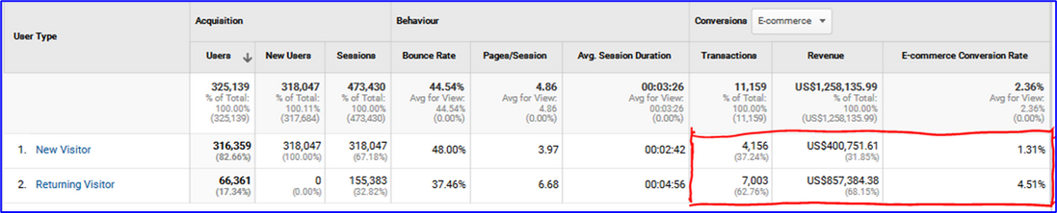
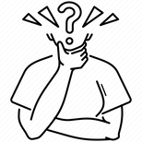
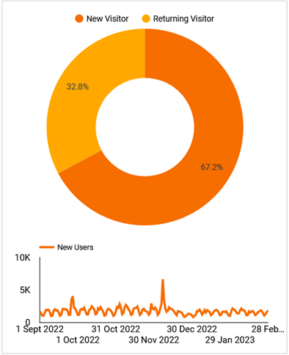
AUDIENCE
What happened?
Majority of users were New Users (67.2%).
New visitors spent less time on the site than returning users.
Returning visitors had a higher conversion rate than new ones.
New visitors bounced away from the website more often than returning ones.
Audience - Behavior - New vs Returning (Conversions: All Goals)
Why?
Do not perform well at retaining visitors
Visitors not interested in making a purchase
Visitors not interested on Google offerings
Expectations not met
Solutions
Creating better and more engaging interface
Redesign its Merchandises store.
Add high quality images.
Optimize and beautify their images.
Show credibility (Adding reviews).

Slide 7
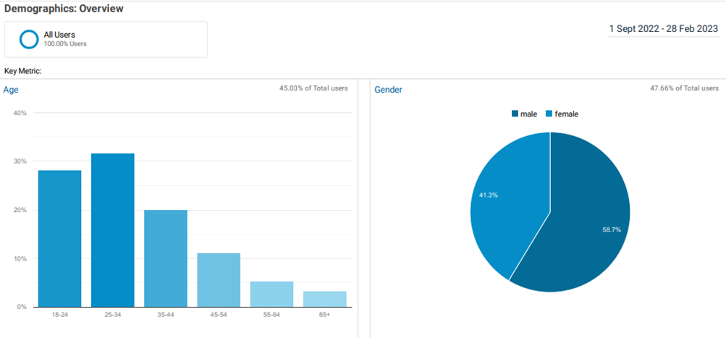
AUDIENCE
Audience - Behavior - New vs Returning (Conversions: E-commerce)
What happened?
Low traffic between age group 55-64 and 65+
Google fails to connect with women.
Solutions
Use different approach to target older demographics(e.g: Facebook. (65+ and 50 - 64 years use Facebook)
Use appropriate engaging language when advertising.
Appealing to the female audience by offering better suited products for both genders.

Slide 8
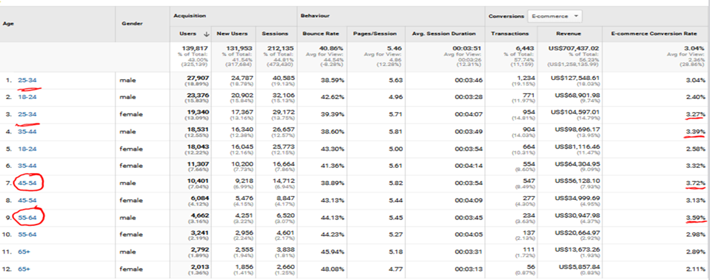
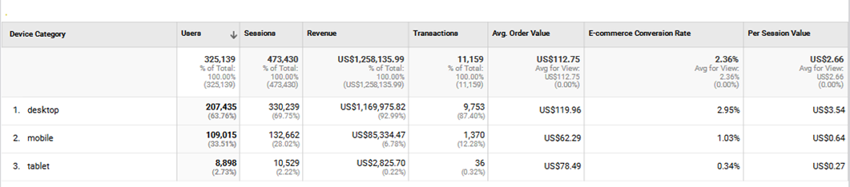
AUDIENCE
Audience - Demographics - Overview
What happened?
Google M.Store generates high revenue from male age group 25-34.
Mobile and desktop devices generate more conversions and value.
Solutions
Audience - Mobile - Overview
Optimizing the website for both mobiles and tablets.
Target the right audience by taking into account marketing initiatives and content
Web design and user experience should cater to age group 65+.

Slide 9
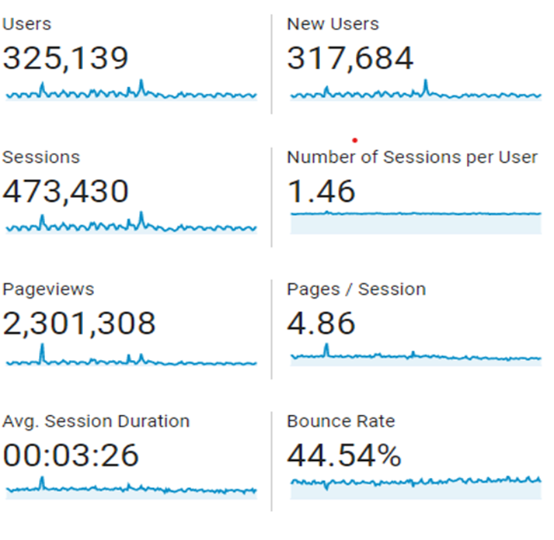
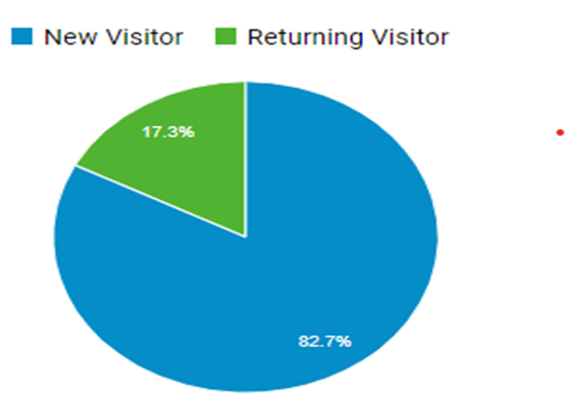
AUDIENCE
What happened?
Google Merchandise Store has a high bounce rate for new visitors at 48%, which means almost half of the people who visit the site leave without clicking on any other page.
There is a low user return rate with only 17.3% of total users.

Slide 10
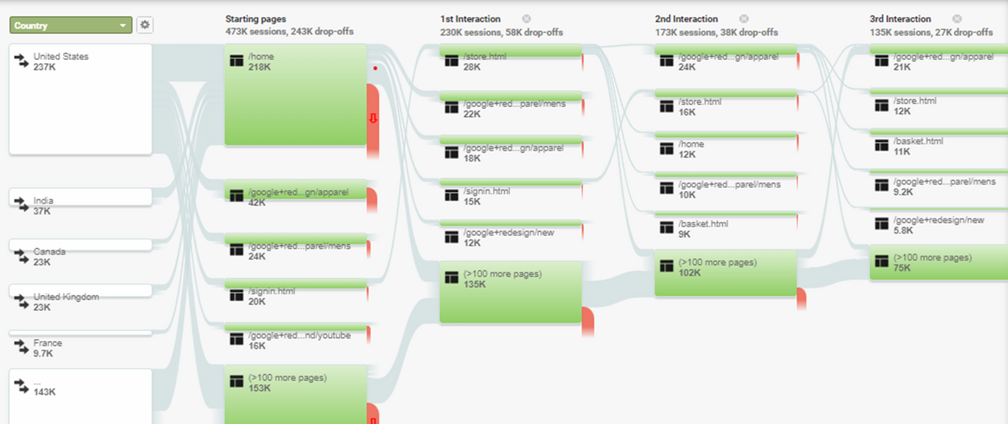
AUDIENCE
Not providing a clear and easy-to-navigate user experience.
Why?
The store's offerings do not meet their expectations
Solutions
New Users
Returning Users
1. Improve website user experience: Focus on improving website navigation.
2.Optimize landing pages: Ensure that landing pages are relevant to the keywords and ads that drive traffic to the site.
1.Customer Retention
2.Implement retargeting campaigns
3.Improve Site Speed
4.Optimize Email Marketing

Slide 11
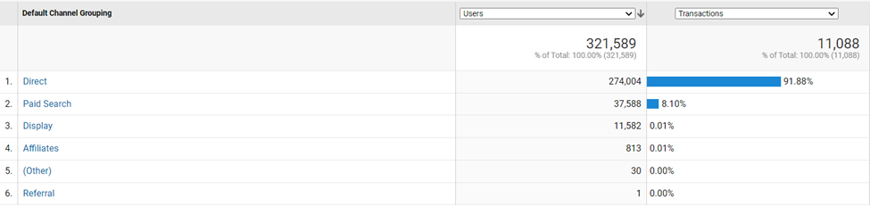

CHANNEL
Acquisition -> Channel report
Paid Search and Display only take account for 8% of transactions
Can we assume that they are not effective and should we discard them from our marketing channel?

Slide 12
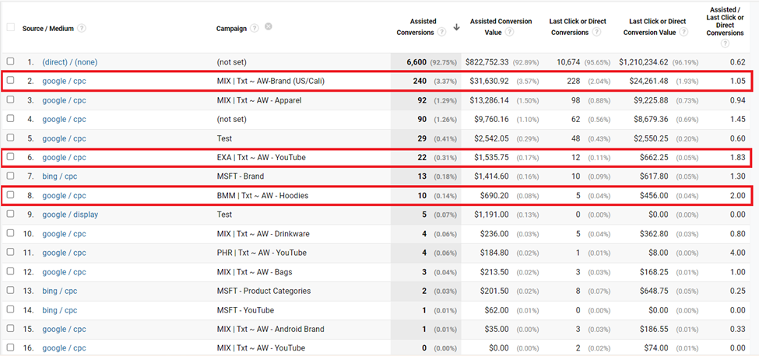


CHANNEL
What happened?
Paid Search has a mixed role: assisting and closing, Direct has functioned as closing
Conversions -> Assisted Conversions reports
Some ad campaigns generate more assisted conversions than others
Direct traffic brought the store more than 1 million dollars value
Why?
Good brand awareness
Promoting products in Google Ads that are relevant to users' search intent but not sufficient
Solutions
Attract the call to action
Increase direct traffic
Decide the type of communication
Invest more on Paid Search
Persuade the user to convert
Raise their brand awareness
Increase the budget on effective campaigns

Slide 13
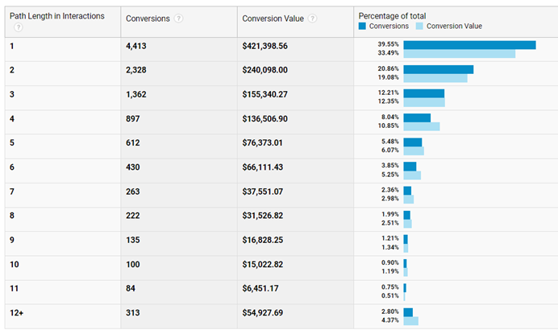
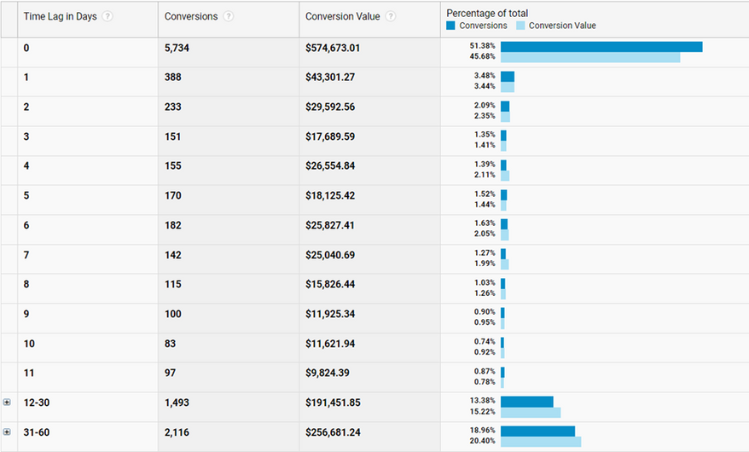
CHANNEL
Path Length
Time lag
Shows how many times a user interacted on your site before conversion.
Tracks the number of days from when a user first interacts with your site to their final conversion.
What happened?
Nearly 40% of people make transactions after 1 interaction
More than 51% of people come to GMS website and make transactions within that day
More than 60% of customers take at least 2 interactions to make a transaction
32% of customers take more than 12 days to make a transaction

Slide 14
CHANNEL
Why?
Solutions
Google M. Store has good brand awareness and many loyal customers
Countinue raising brand awareness
Customer may be looking for more information to evaluate how well Google M.Store meets their needs.
Develop Chatbots to assist
Customers may not have enough motivation to make a purchase
Engage customers in-channel by well-timed follow-up email, informing sales or promos, etc

Slide 15
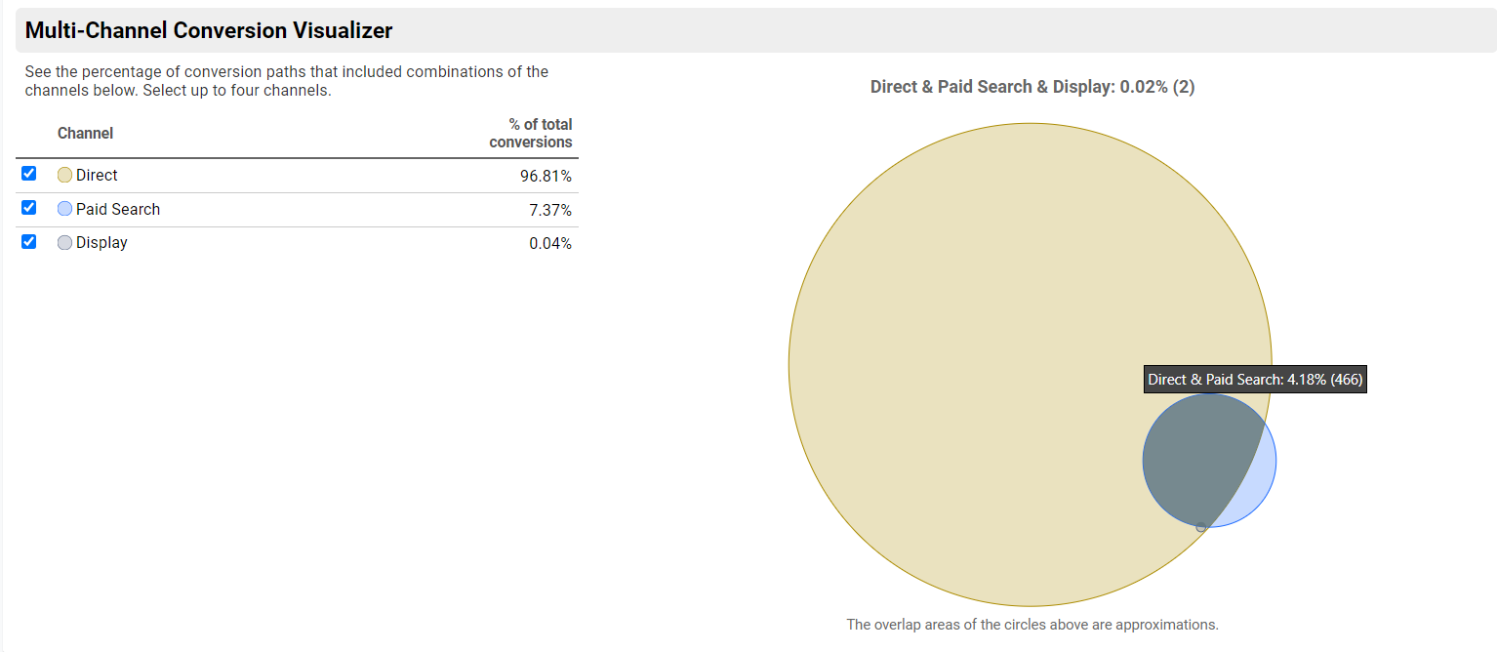
CHANNEL
4.68% of total conversions came through direct and paid search.
Paid search brings customers to the site at first
When customers have demand later, they will go directly to the site to make transaction

Slide 16
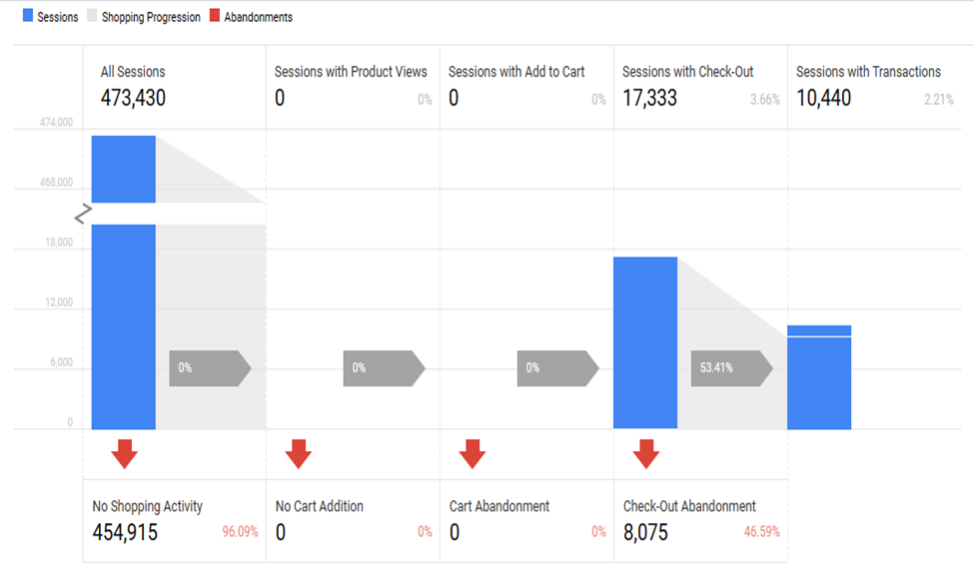
PRODUCTS
What happened?
Ecommerce -> Shopping Behavior
Users visited the Google Merchandise store but navigating through the Product page were met with some challenges
Why?
0 sessions with product views
No direct link between ads and landing page
Sessions with no cart addition
Mismatched product viewed from ads
Unavailability of matched products for visitors
Solutions
Prioritize main product ads as number 1
Products on the website should be identical to the products in the ads
Update the availability feature of the product
Improved landing page
Avoid hiding key layouts of the product photography
Ensure add to cart functionality is visible and easy to use

Slide 17
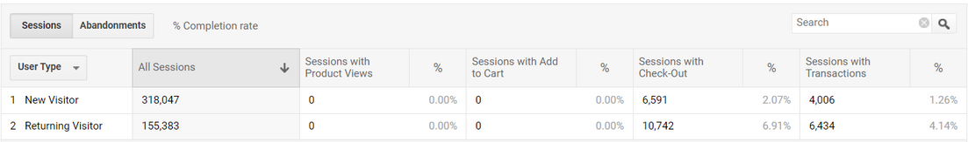
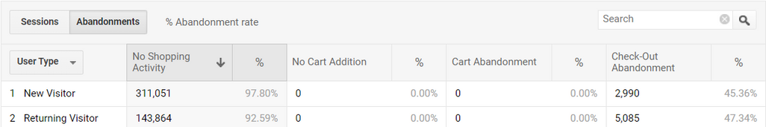
PRODUCTS
Ecommerce - Shopping Behavior
What happened?
High check out abandonment
Solutions
Why?
Disapproved delivery time frame
Inclusive delivery and shipping options inclusive
Inadequate payment security
Improve payment quality security
Shipping or additional charges
Remove unexpected additional charges at check-out point

Slide 18
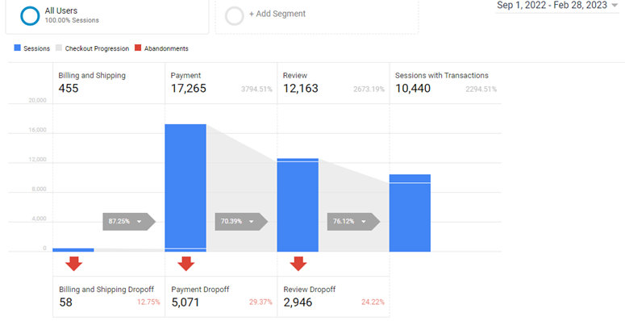
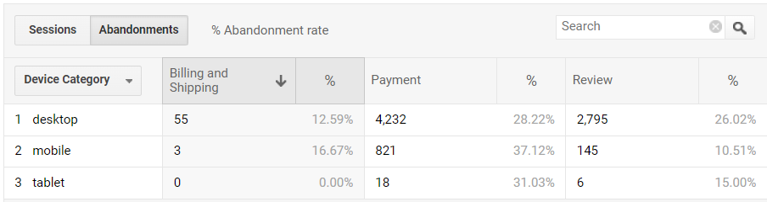
PRODUCTS
Conversions -> Ecommerce -> Checkout behaviour
What happened?
12.75% of the visitors opt out at the billing and shipping session while 87.25% progress to make payment
At the payment session 70.39% of the 17,265 transaction progressed while 29.37% dropoff
Worth checking abandonment rate
More abandonment comes from mobile phone users

Slide 19
PRODUCTS
Why?
Solutions
External distraction
Remind visitors of their transaction
Shipping price
Provide various alternatives shipping method or offering other logistic partners
Relative high price
Analyze average price in the market/industry/category
Quality and Size anxiety
Increase the number of reviews with pictures and video as many as possible
Lack of motivation to review
Reward those who review
Limited payment options
Provide more payment options like COD, digital wallets, etc
Poor mobile users experience
Improve Mobile users experience

Slide 20

CONCLUSIONS
Google Merchandise Store has very brand awareness
Google Merchandise Store’s main target audience is male age group 25-34
Poor user experience
Direct traffic is the most efficient
High check out abandonment rate
Customers have difficulties in finding information in Google Merchandise Store website
Customers are not satisfied with current Google Merchandise Store services (payment, delivery, etc)

Slide 21
PROPOSED SOLUTIONS
Improve user experience (in destop, mobile)
Modify strategy to reach out to every age group
Improve landing pages (shows all high quality elements of the product, be relevant to the keywords and ads)
Raise their brand awareness
Engage customers in-channel (email, chat, advertisement, etc)
Improve services/features (payment, delivery, photography, Chatbot, etc)
Creating better and more engaging interface
Investing more in Paid Search (Google ads, etc)

Slide 22
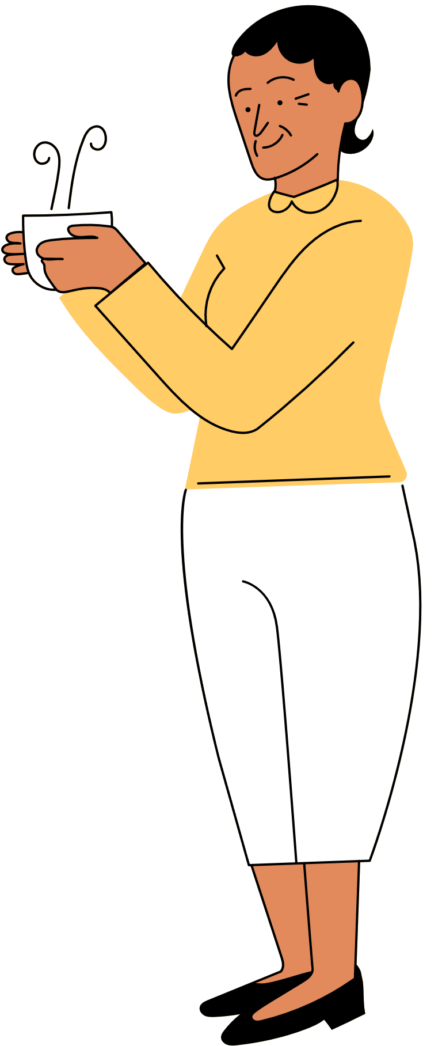
THANK
YOU!
Have a great day ahead.

